Slide 1
렌더링 -Lights - Material (reflection model) -Texture

Slide 2
Transformation
3D Primitives
Model Transformation
Transform into 3D World Coordinate System
Illustrate According to
Lighting and Reflectance
Lighting
Viewing Transformation
Transform into 3D Viewing Coordinate System
Projection Transformation
Transform into 2D Viewing Coordinate System
Clipping
Clip Primitives outside Window’s View
Viewport Transformation
Transform into Viewport
Scan Conversion
Draw Pixels
Image

Slide 3
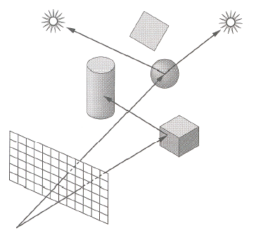
Shading
Compute the radiance for each object
Figure out which pixels to fill
Determine a color for each filled pixel

Slide 4
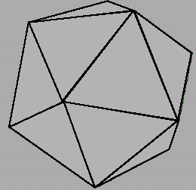
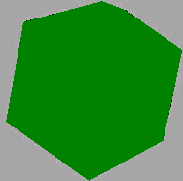
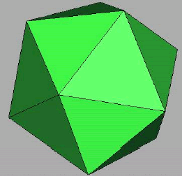
Illumination Components
Emission at light sources
Scattering at surfaces
Wireframe
Without Illumination
With Illumination

Slide 5


Light Source Model
Simple mathematical models
Point light
Directional light
Spot light

Slide 6
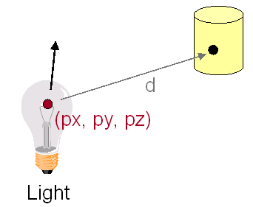
Point Light Source
Omni-directional point source, ex) bulb
Intensity (I)
Position (px, py, pz)

Slide 7
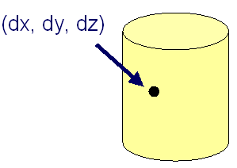
Directional Light Source
Point light source at infinity, ex) sun
Intensity (I)
Direction (dx,dy,dz)

Slide 8
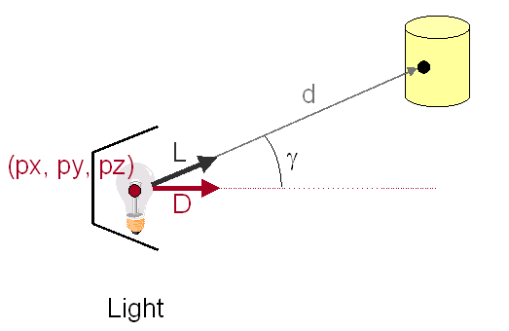
Spot Light Source
Point light source with direction, ex) Luxo
Intensity (I)
Position (px, py, pz)
Direction (dx, dy, dz)

Slide 9
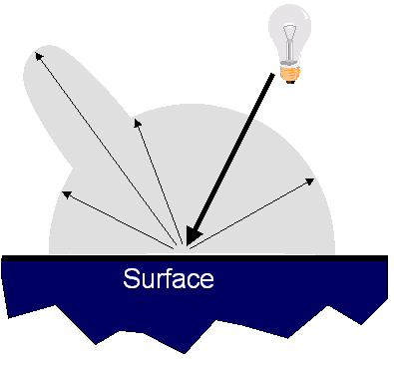
Reflectance Model
Simple analytic model
Emission
Ambient
Diffuse reflection
Specular reflection

Slide 10
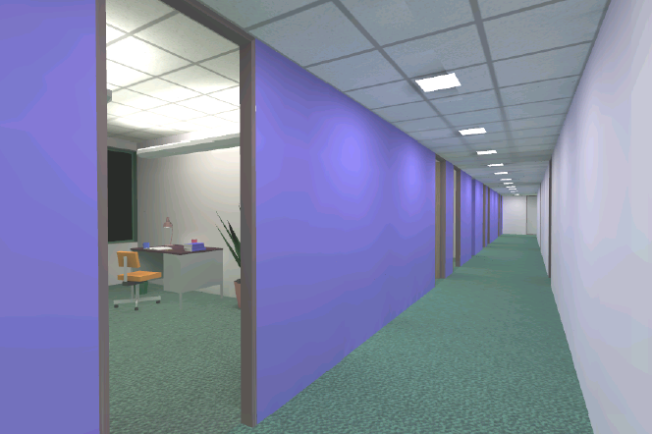
Emission
Light emitting directly from surfaces
ex) light source
Emission ≠ 0

Slide 11
Ambient Term
Compensated reflection of indirect illumination

Slide 12
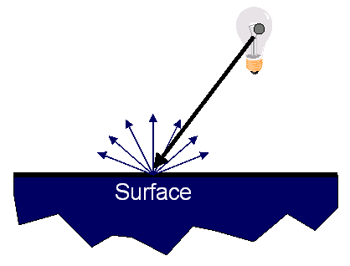
Diffuse Reflection
Surface reflects equally in all directions
With equal intensity

Slide 13
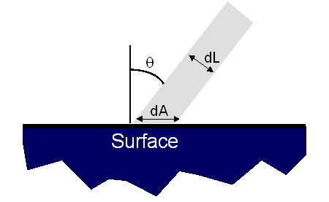
Diffuse Reflection
How much light is reflected?
Depends on angle of incident light
dL = dA cos θ = Ν ⋅ L
Maximum at the head-on light (θ = 0)
N
L

Slide 14
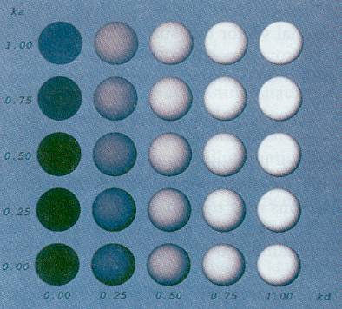
Ambient and Diffuse
Ambient
Diffuse

Slide 15
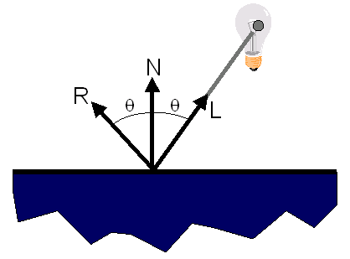
Specular Reflection
Strongest reflection near the mirror angle
Examples: mirrors, metals

Slide 16
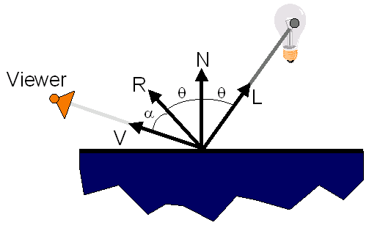
Specular Reflection
How much light is reflected?
Depends on
Angle of incident light
Angle to viewer

Slide 17
Specular Reflection
Phong model
{cos(α)}^{n} = (V⋅R)^{n}
n: exponent
Ks: Specular Reflectance Factor

Slide 18
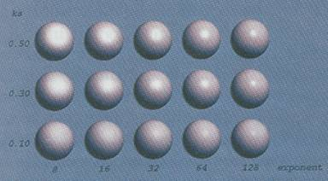
Effects of Exponent
Ambient
Exponent(n)

Slide 19
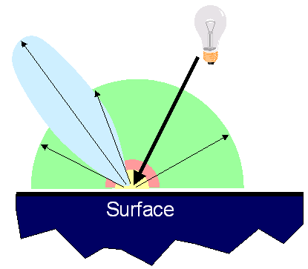
Reflectance Model
Simple analytic model
Emission
Ambient
Diffuse reflection
Specular reflection

Slide 20
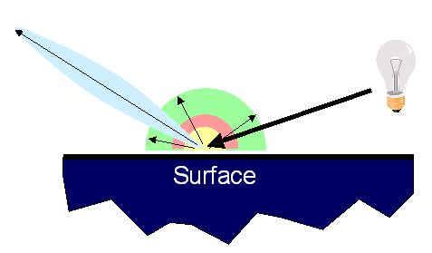
Reflectance Model
Simple analytic model
Emission
Ambient
Diffuse reflection
Specular reflection
Not affected by the position of the light source
Affected by the position of the light source

Slide 21
3D Rendering Pipeline
3D Primitives
3D Modeling Coordinates
Model Transformation
3D World Coordinates
Lighting
3D World Coordinates
Viewing Transformation
3D Viewing Coordinates
Projection Transformation
2D Projection Coordinates
Surface details
can be added...
Clipping
2D Projection Coordinates
Viewport Transformation
2D Device Coordinates
Scan Conversion
2D Device Coordinates
Image

Slide 22
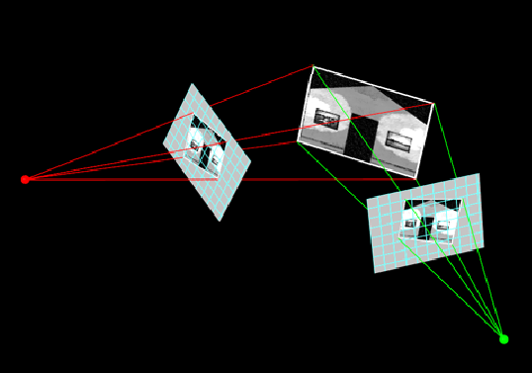
Texture Mapping
2D projective transformation
Texture coordinate system (s, t) to
Device coordinate system (x, y)

Slide 23
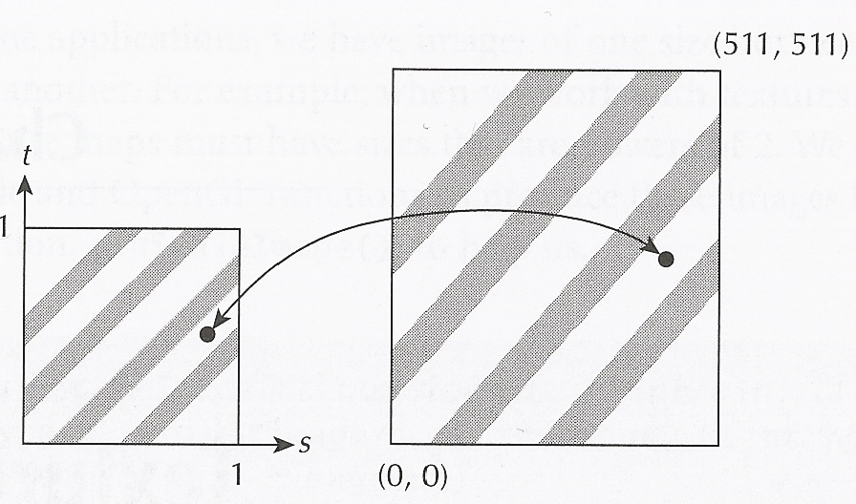
2D Texture
Texture map as a continuous (s, t) coordinate space [0,1]
For mapping it into a discrete texture image space
Texture Map
Texture Image

Slide 24
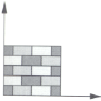
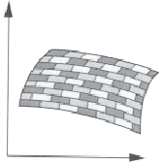
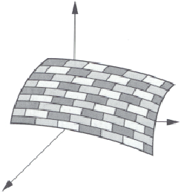
Textures
Color variation in interior of 3D polygon
When scan converting a polygon
Vary pixel colors according to values fetched from a texture
t
y
y_{s}
Texture-Surface
Transformation
Viewing and Projection
Transformation
x
s
x_{s}
z
Texture Space
Object Space
Image Space

Slide 25
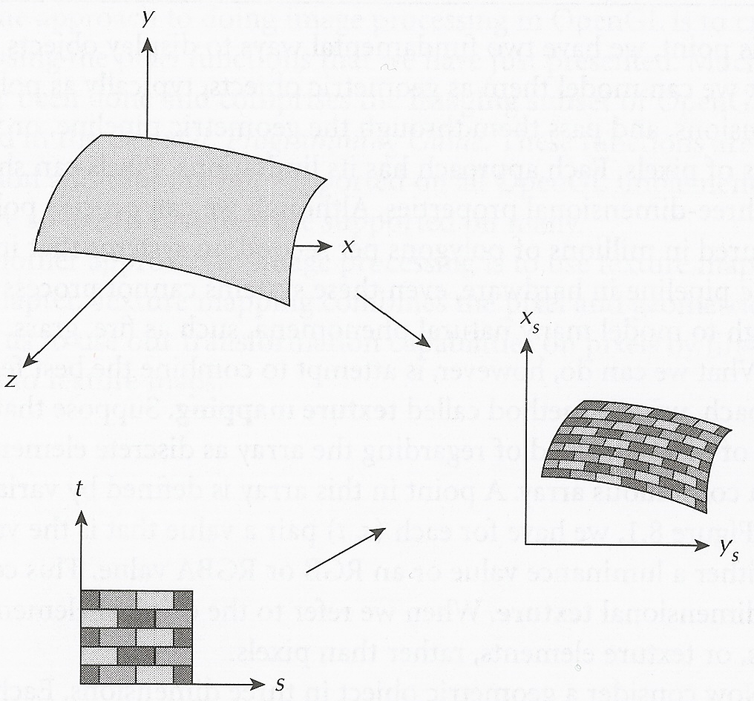
Texels and Textures
Texels – texture elements
Texture coordinates (s, t)

Slide 26
Texture Mapping Overview
Steps:
Define texture
Specify mapping from texture to surface
Lookup texture values during scan conversion
(0, 1)
t
(1, 0)
v
y
s
(0, 0)
u
x
Texture
Coordinate
System
Modeling
Coordinate
System
Device
Coordinate
System

Slide 27
Texture Mapping Process
Scan conversion
Interpolate texture coordinates
Distortion due to the bilinear interpolation
Subdivide the polygon into smaller ones
(u₁, v₁)
α
β
γ
(u₂, v₂)
(u₃, v₃)

Slide 28
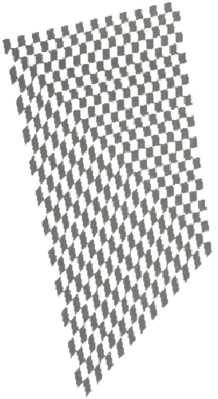
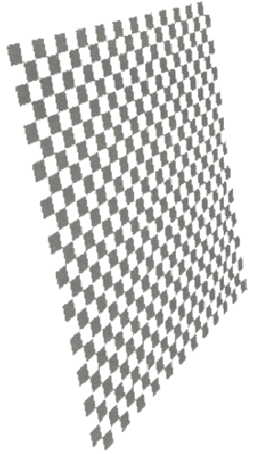
Texture Mapping : Artifact of Linear Interpolation
Linear Interpolation
of Texture Coordinate
Corrected Interpolation

Slide 29
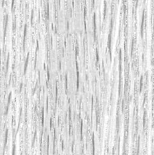
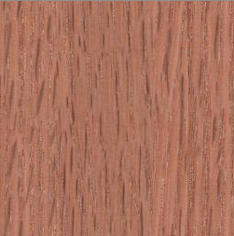
Texture Modulation
Texture
Shaded Color
Texture Value

Slide 30
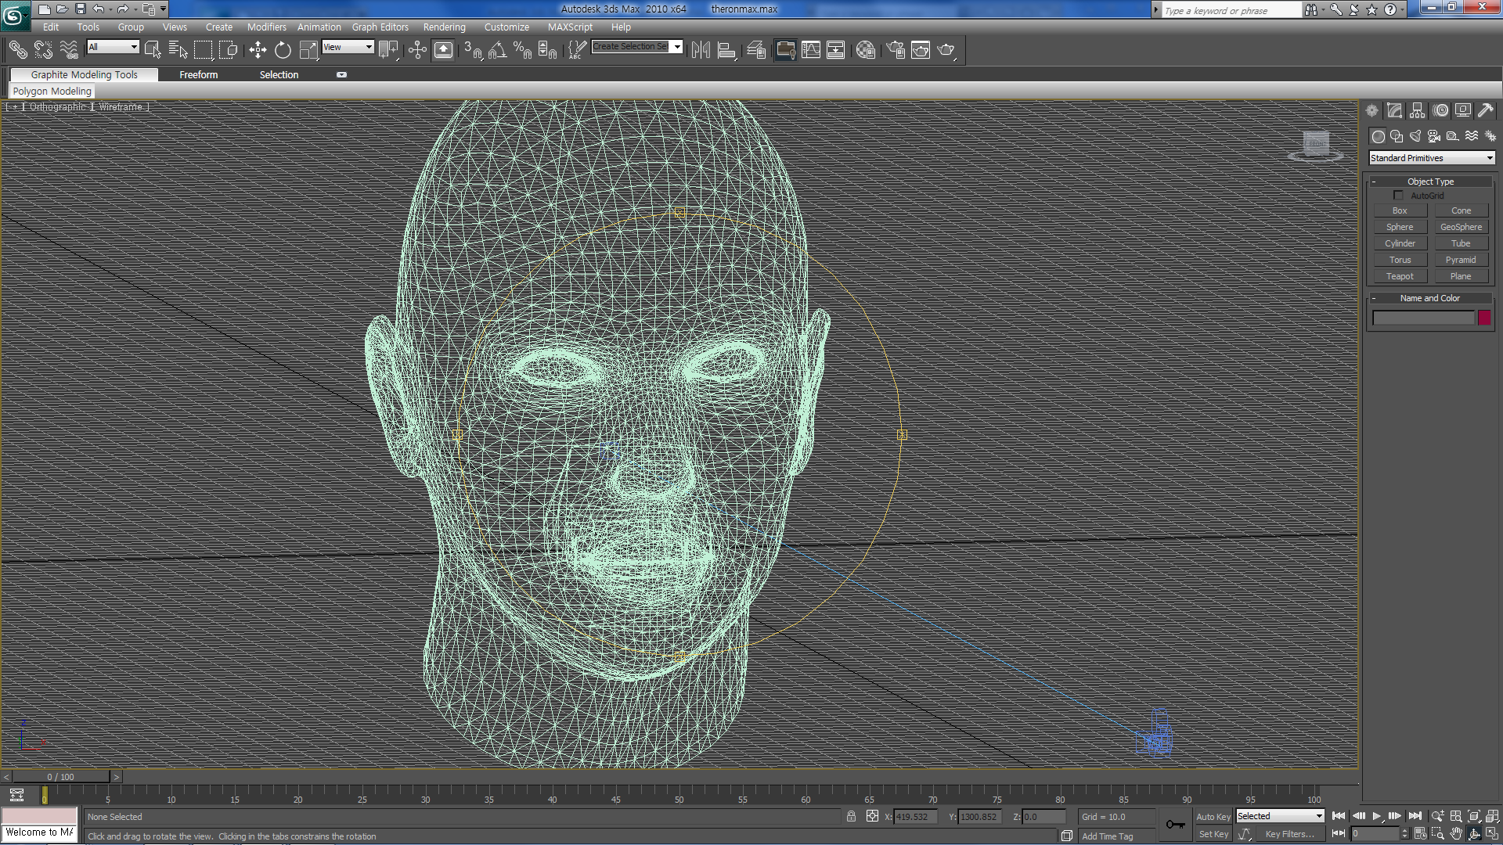
Geometry Model (Mesh)

Slide 31
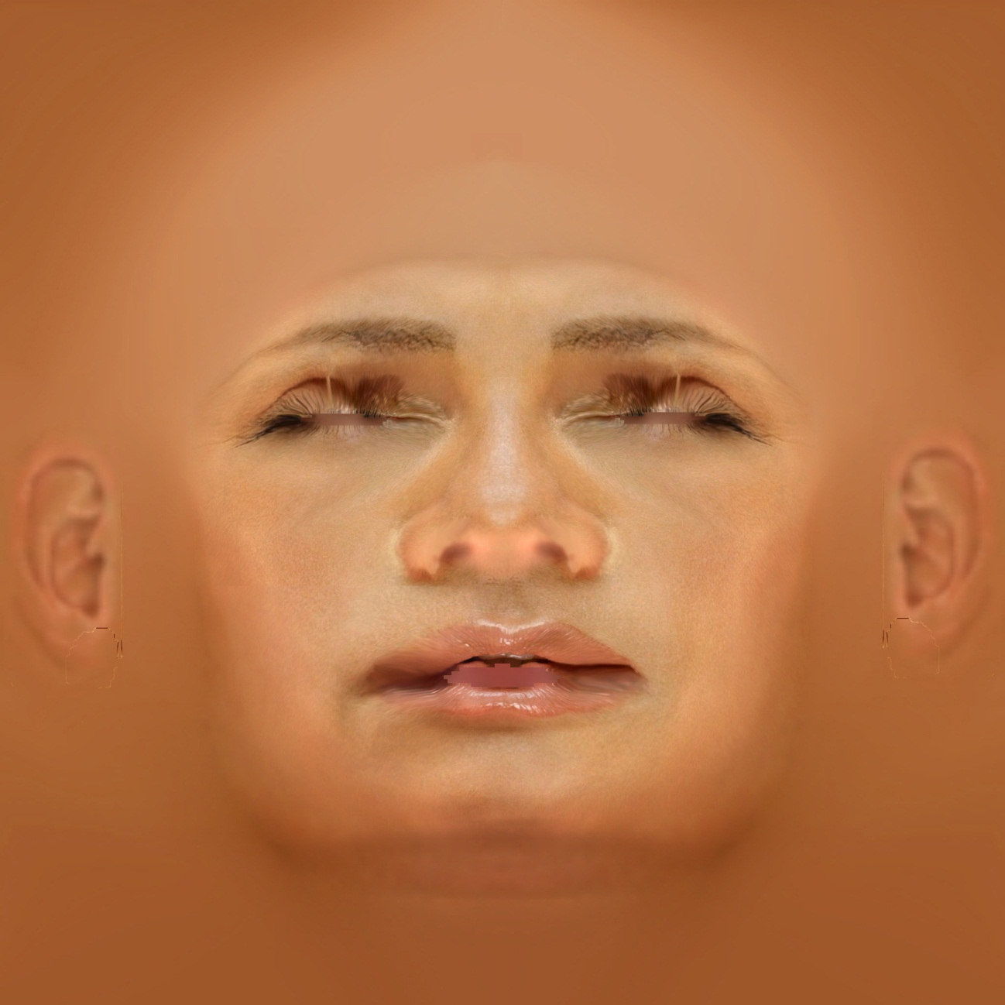
Texture Image

Slide 32
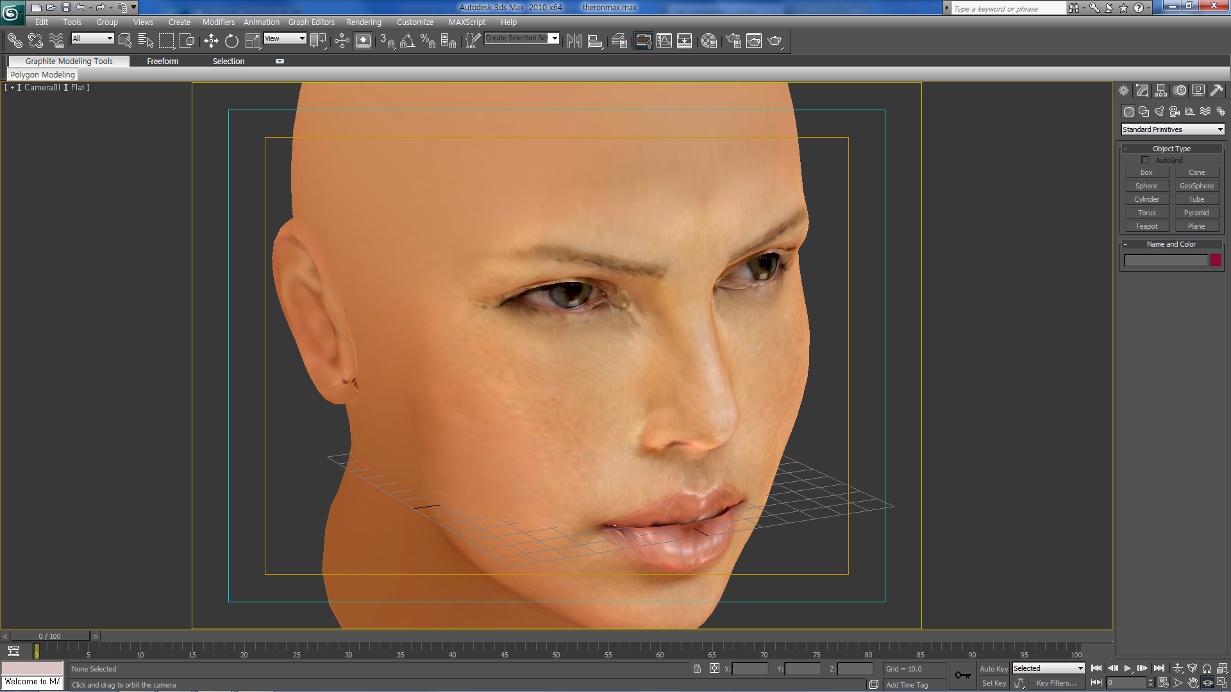

Texture + Mesh

Slide 33
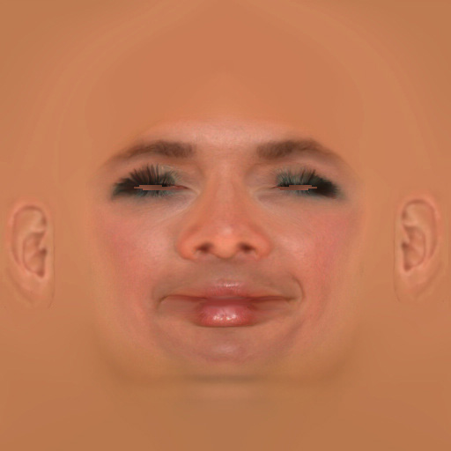
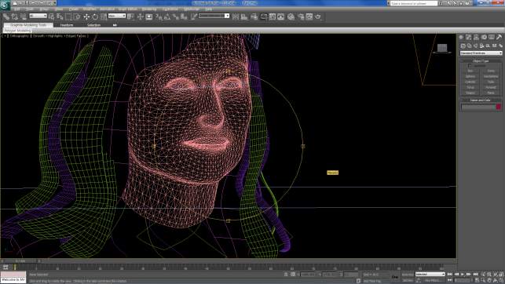
Whose Facial Texture?

Slide 34


